Slide 1
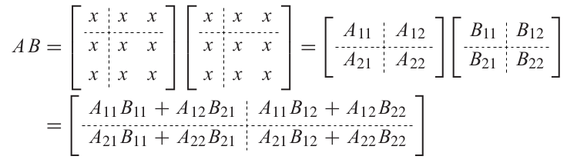
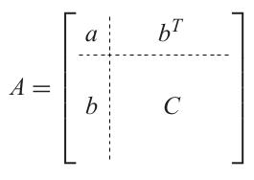
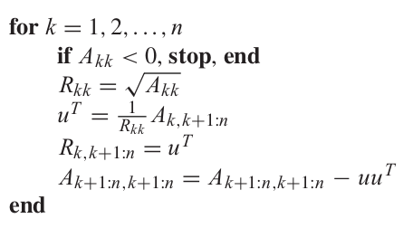
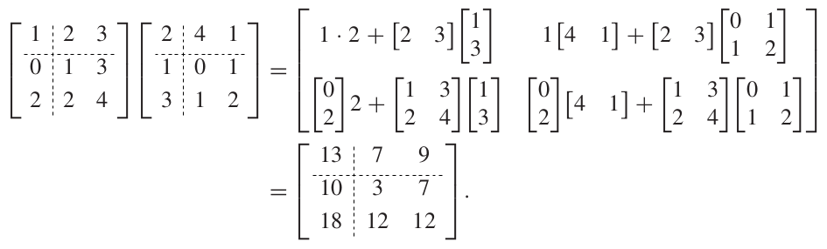
cholesky factorization theorem
first, block multiplication.
theorem 14. if A_{nxn} is symmetric positive definite, then there exists an upper triangular R_{nxn} such that A = R^{T}R.
⇒
then two back-substitutions: R^{T}c = b, Rx = c.

